Slide 1
DATA LINK CONTROL

Slide 2
Data Link Layer Design Issues
Services Provided to the Network Layer
Framing
Error Control
Flow Control

Slide 3



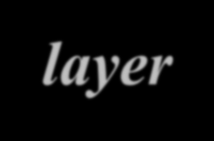













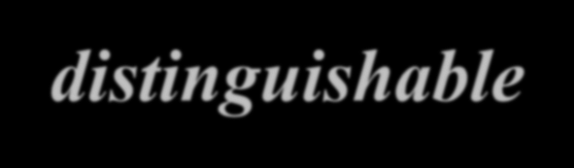







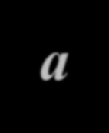






















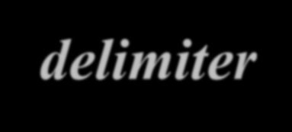

FRAMING
The data link layer needs to pack bits into frames, so that each frame is distinguishable from another. Our postal system practices a type of framing. The simple act of inserting a letter into an envelope separates one piece of information from another; the envelope serves as the delimiter.
Topics discussed in this section:
Fixed-Size Framing Variable-Size Framing

Slide 4
Types of Framing
Fixed Size Framing
Variable | Size Framing--- | Character
oriented | protocols and Bit | oriented
Protocols.

Slide 5
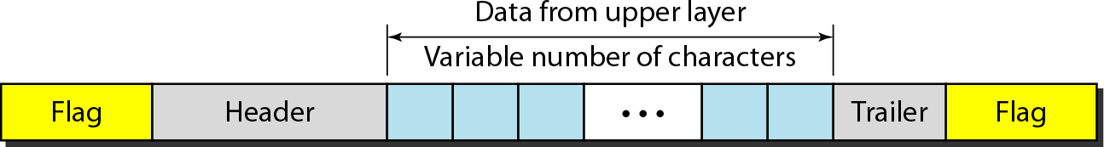
A frame in a character-oriented protocol

Slide 6
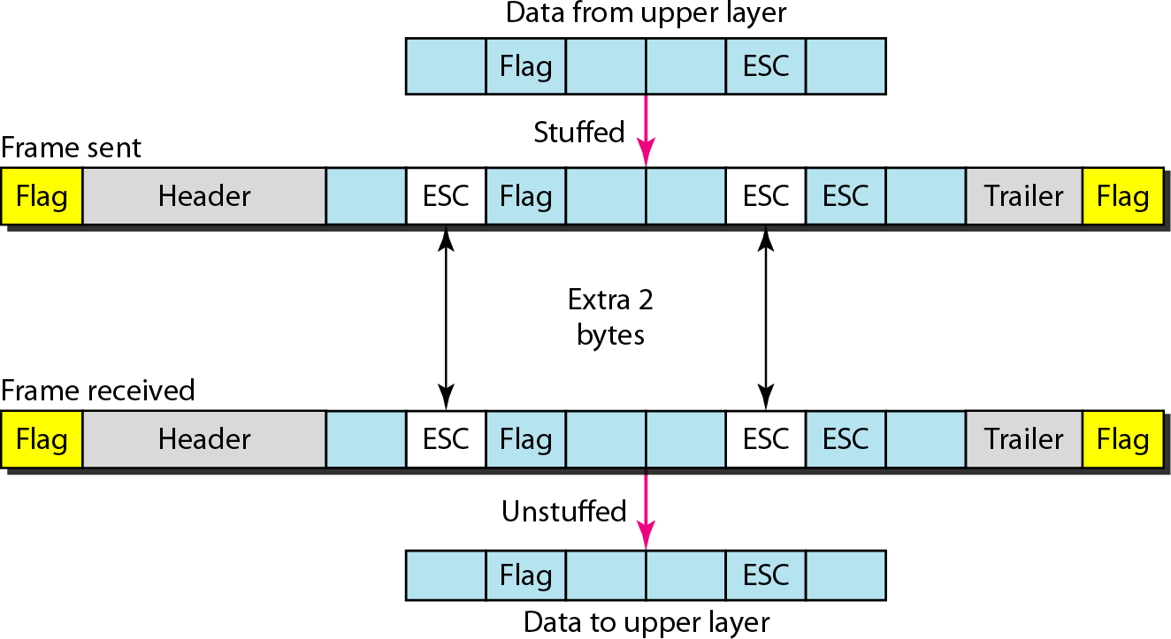
Byte stuffing and unstuffing

Slide 7




Note
Byte stuffing is the process of adding 1 extra byte whenever there is a flag or escape character in the text.

Slide 8
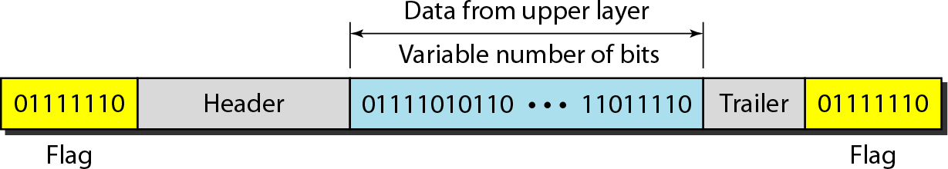
A frame in a bit-oriented protocol

Slide 9
Bit stuffing is the process of adding one extra 0 whenever five consecutive 1s follow a 0 in the data, so that the receiver does not mistake
the pattern 0111110 for a flag.
Note

Slide 10
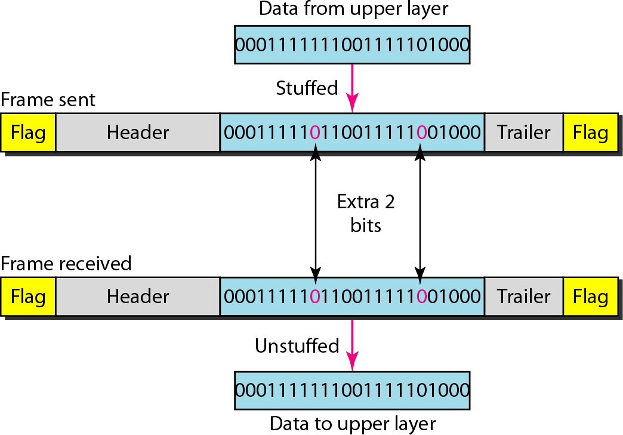
Bit stuffing and unstuffing

Slide 11



























FLOW AND ERROR CONTROL
The most important responsibilities of the data link layer are flow control and error control. Collectively, these functions are known as data link control.
Topics discussed in this section:
Flow Control
Error Control

Slide 12
Note
Flow control refers to a set of procedures used to restrict the amount of data
that the sender can send before waiting for acknowledgment.

Slide 13
Note
Error control in the data link layer is based on automatic repeat request, which is the retransmission of data.

Slide 14
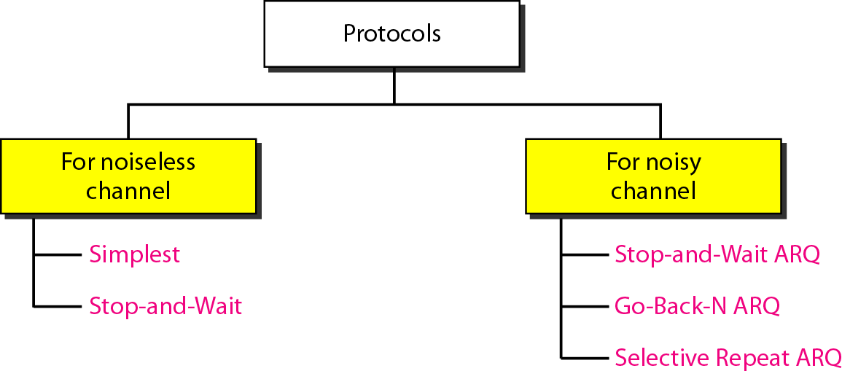
Taxonomy of protocols discussed in this chapter

Slide 15
















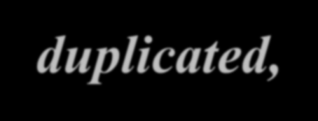





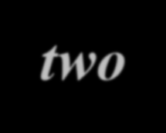






NOISELESS CHANNELS
Let us first assume we have an ideal channel in which no frames are lost, duplicated, or corrupted. We introduce two protocols for this type of channel.
Topics discussed in this section:
Simplest Protocol
Stop-and-Wait Protocol

Slide 16
Simplest Protocol
No flow and Error Control

Slide 17
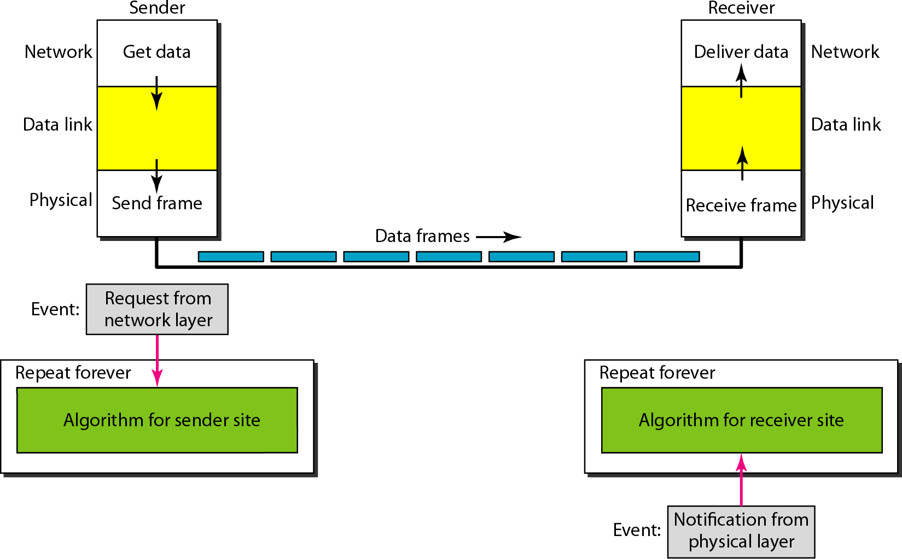
The design of the simplest protocol with no flow or error control

Slide 18
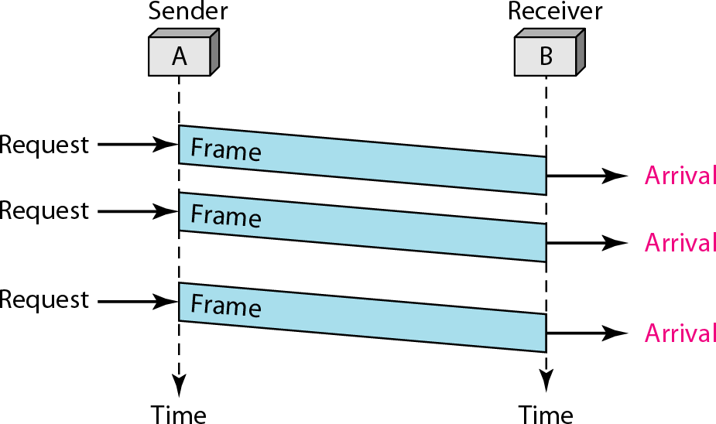
Flow diagram for Simplest

Slide 19
Stop-and-Wait Protocol
Sender sends one frame, stops until it gets confirmation from receiver.

Slide 20
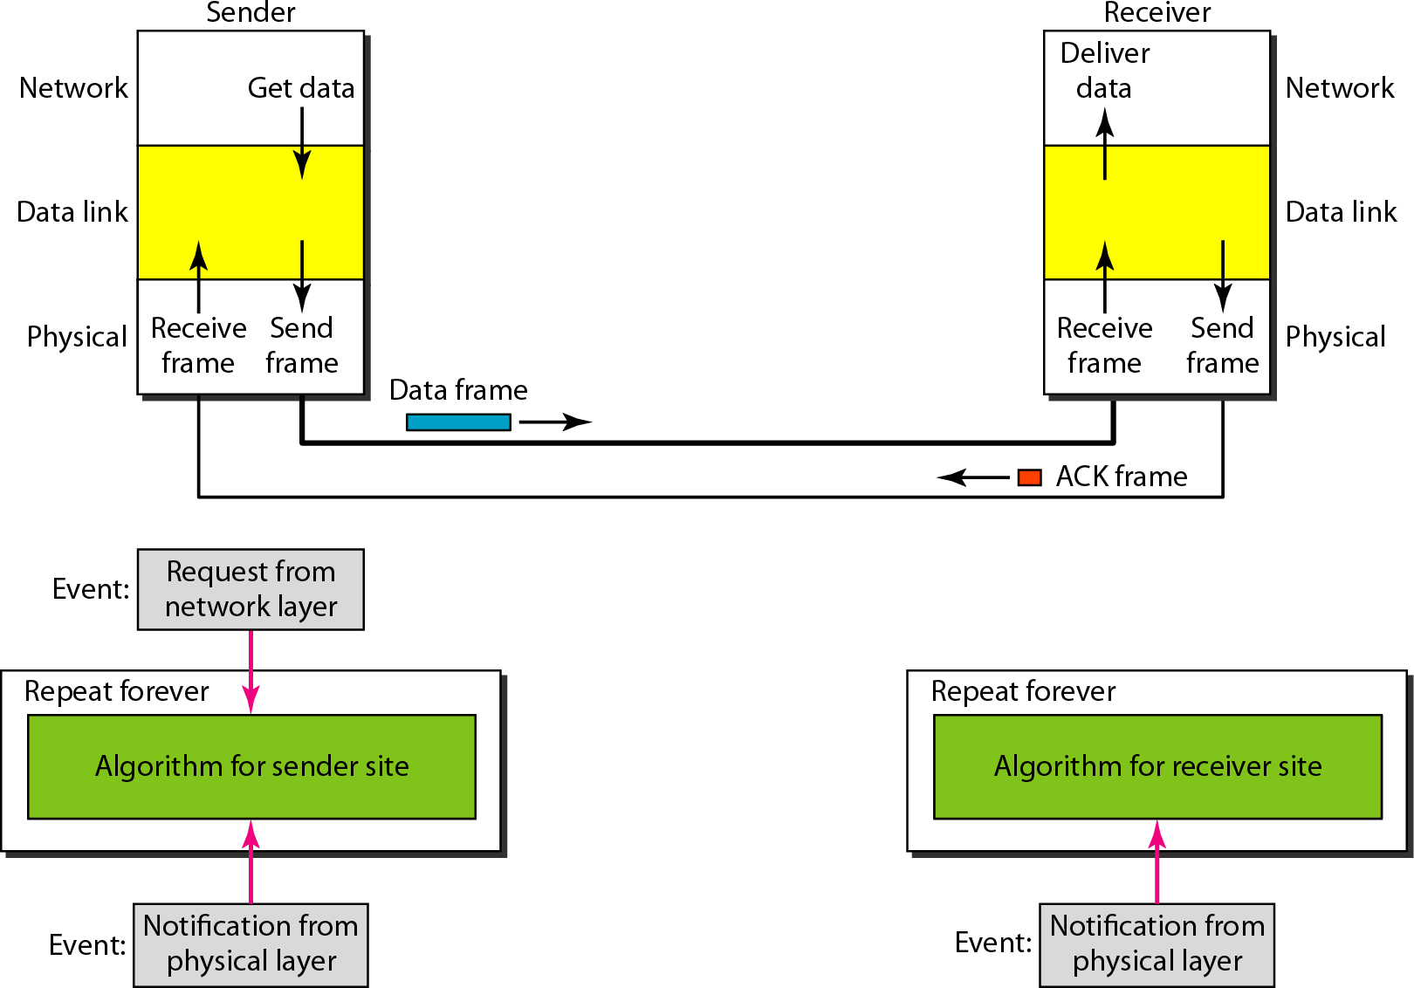
Design of Stop-and-Wait Protocol

Slide 21
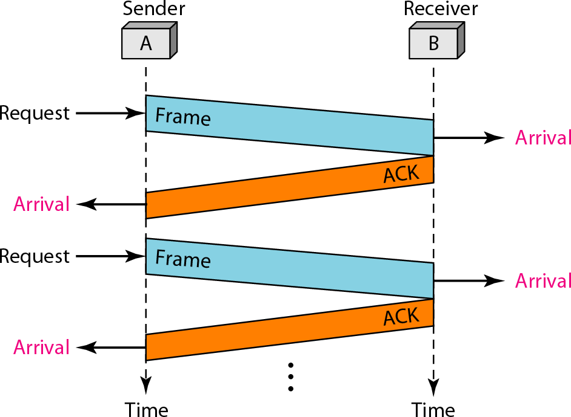
Flow diagram for Stop and Wait

Slide 22




































NOISY CHANNELS
Although the Stop-and-Wait Protocol gives us an idea of how to add flow control to its predecessor, noiseless channels are nonexistent. We discuss three protocols in this section that use error control.
Topics discussed in this section:
Stop-and-Wait Automatic Repeat Request Go-Back-N Automatic Repeat Request Selective Repeat Automatic Repeat Request

Slide 23
Note
In Stop-and-Wait ARQ, we use sequence numbers to number the frames.
The sequence numbers can be 1,0,1,0,1…

Slide 24
Note
In Stop-and-Wait ARQ, the acknowledgment number is 0 if sequence number is 1 and acknowledgment number is 1 if sequence number is 0

Slide 25
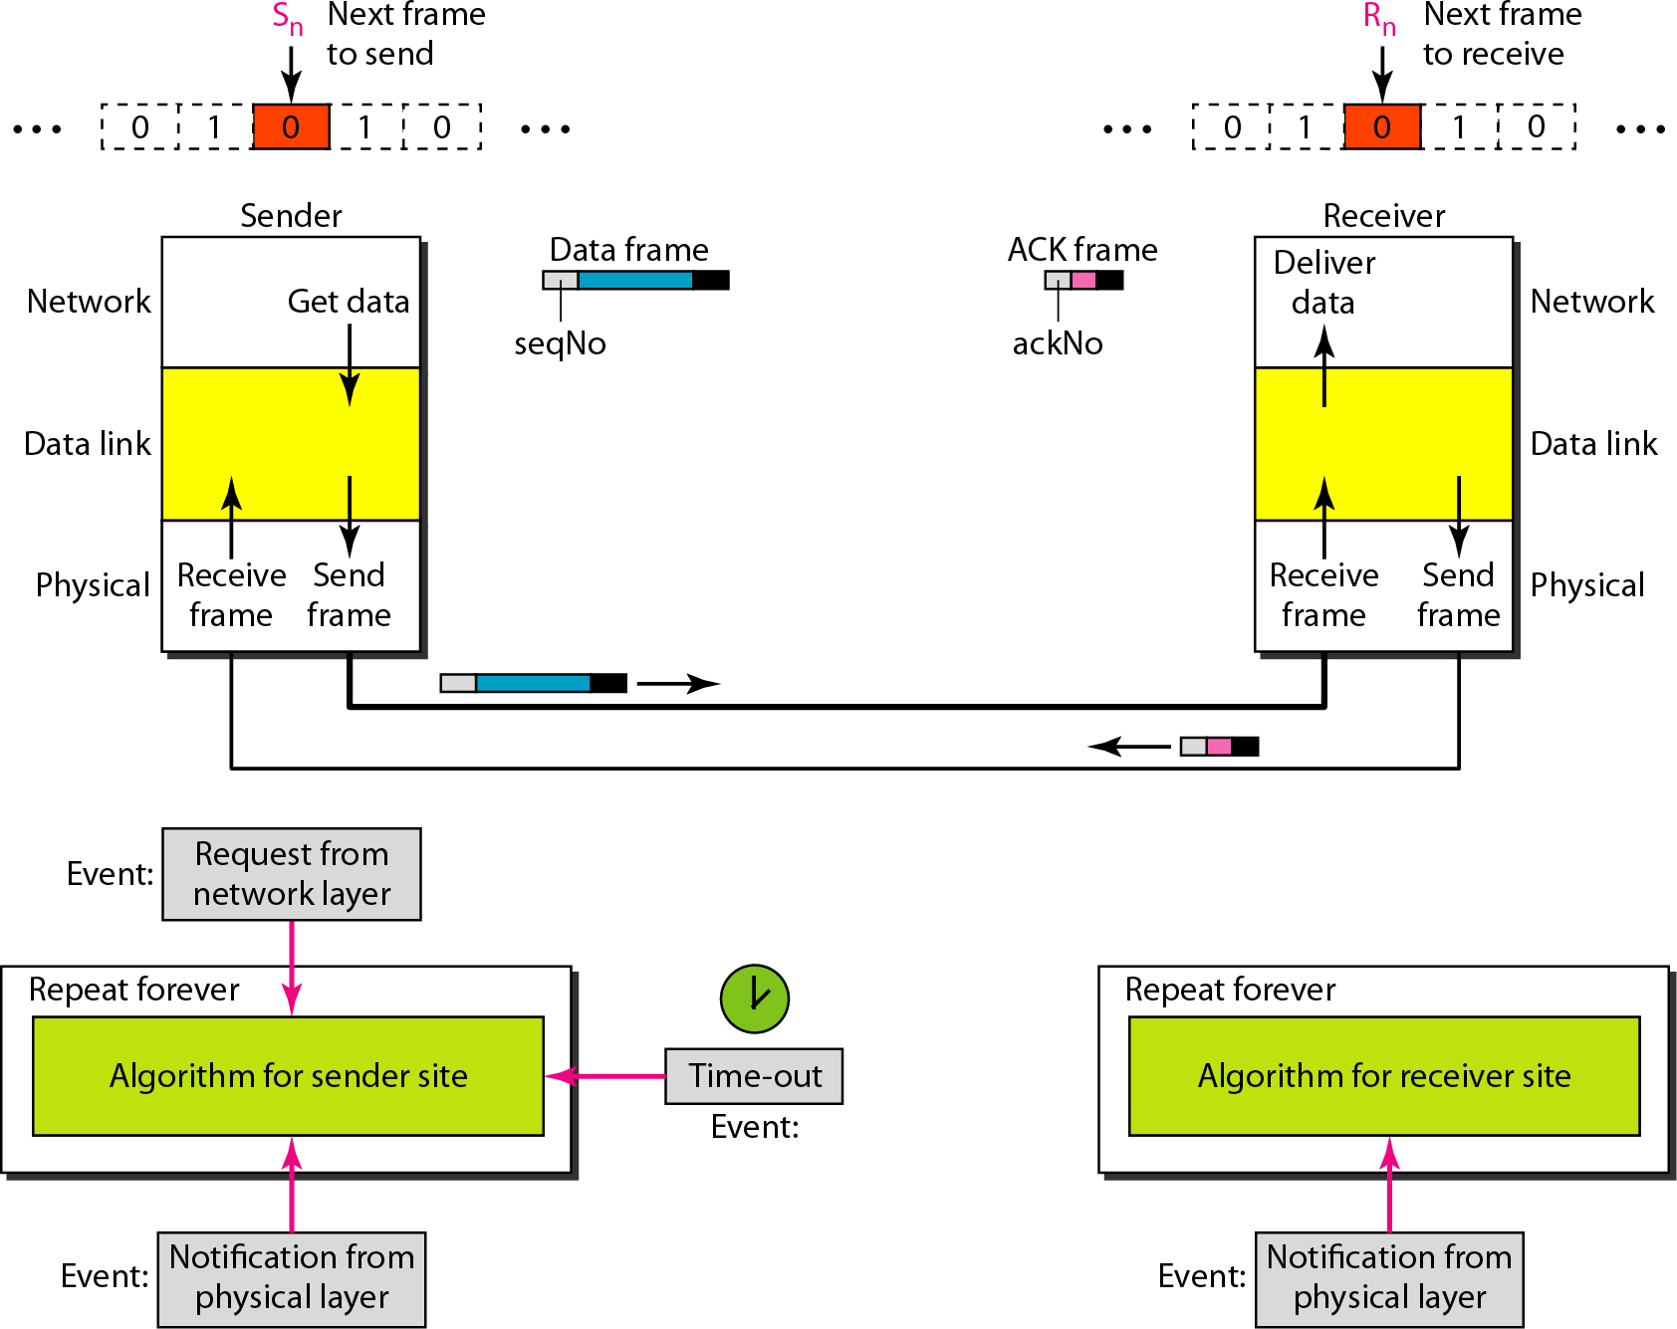
Design of the Stop-and-Wait ARQ Protocol

Slide 26
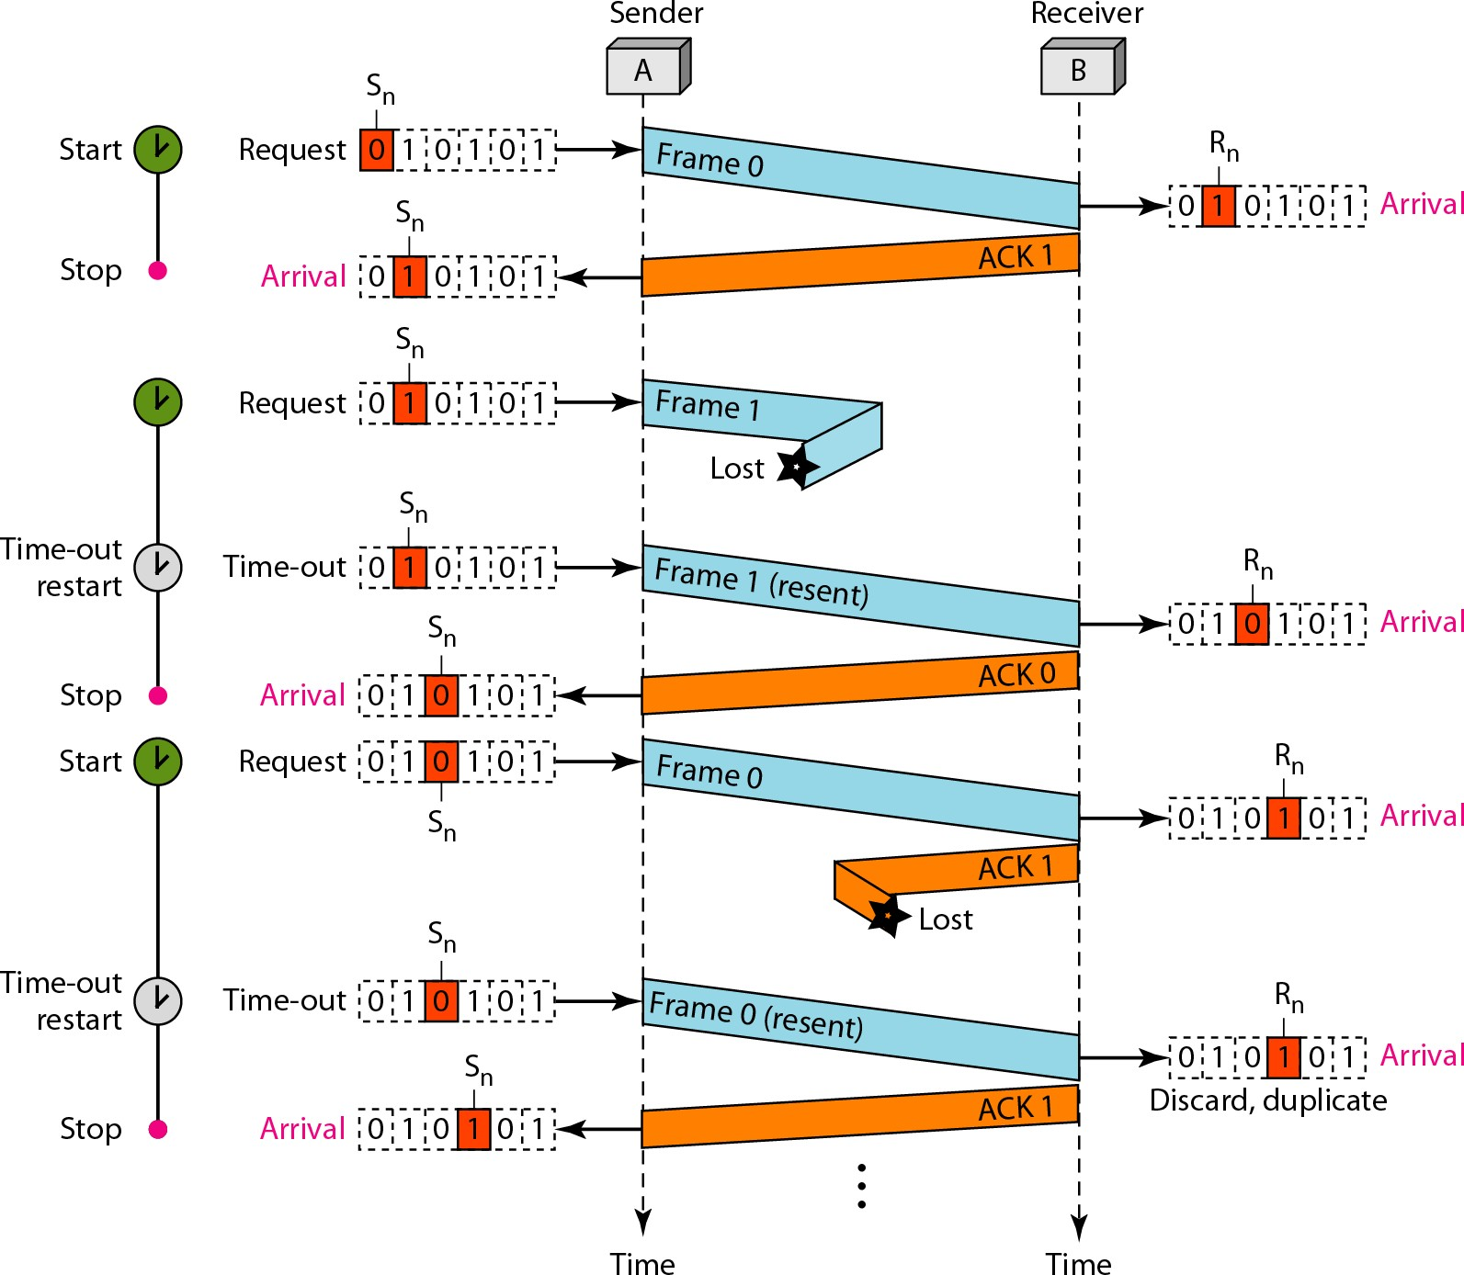
Flow diagram for Example 11.3

Slide 27
Disadvantage Stop-and-Wait ARQ Protocol
Inefficient---if channel is thick and long
Thick means high bandwidth
Long means roundtrip delay
Product of both is bandwidth delay.
Bandwidth delay is number of bits we can send while waiting for news from receiver.

Slide 28
Assume that, in a Stop-and-Wait ARQ system, the bandwidth of the line is 1 Mbps, and 1 bit takes 20 ms to make a round trip. What is the bandwidth-delay product? If the system data frames are 1000 bits in length, what is the utilization percentage of the link?
Solution
The bandwidth-delay product is
11.28

Slide 29
Pipelining
Task begins before end of first task.
Stop-and-Wait ARQ does not use pipelining but other two techniques do.
This improves efficiency.

Slide 30
Go-Back-N Protocol
This sends multiple frames before receiving acknowledgment from receiver.

Slide 31
Note
In the Go-Back-N Protocol, the sequence numbers are modulo 2^{m},
where m is the size of the sequence number field in bits.

Slide 32
Sliding Window
Defines the range of sequence numbers that is concern of sender and receiver.
The range which is concern of sender is called sender sliding window.
The range which is concern of receiver is called receiver sliding window.

Slide 33
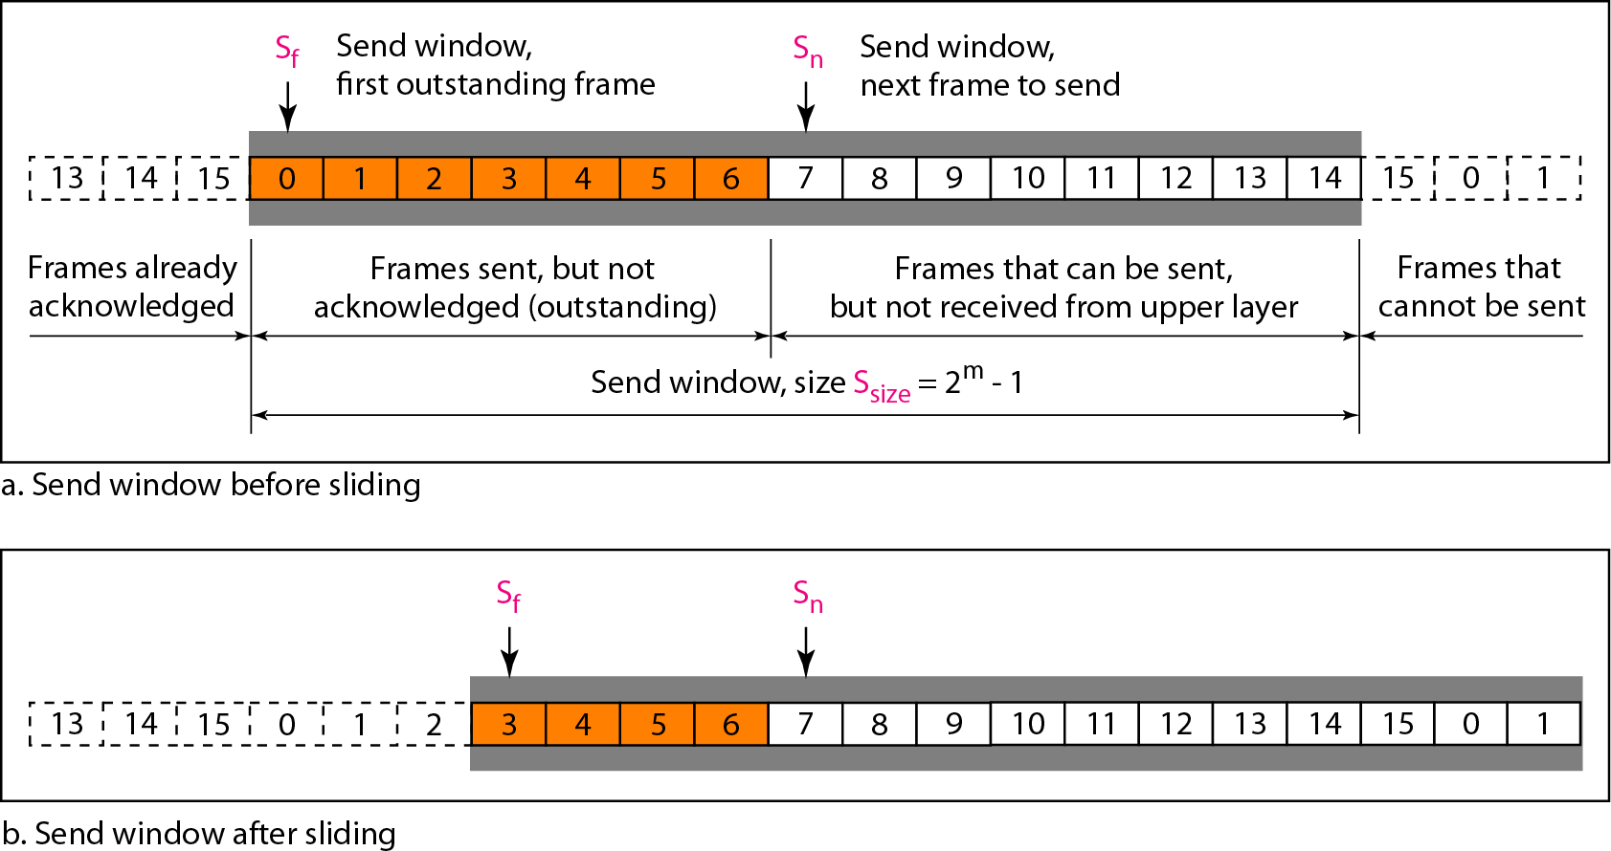
Send window for Go-Back-N ARQ

Slide 34
Note
The send window is an abstract concept defining an imaginary box of size 2^{m} − 1 with three variables: S_{f}, S_{n}, and S_{size}.

Slide 35
Note
The send window can slide one or more slots when a valid acknowledgment arrives.

Slide 36
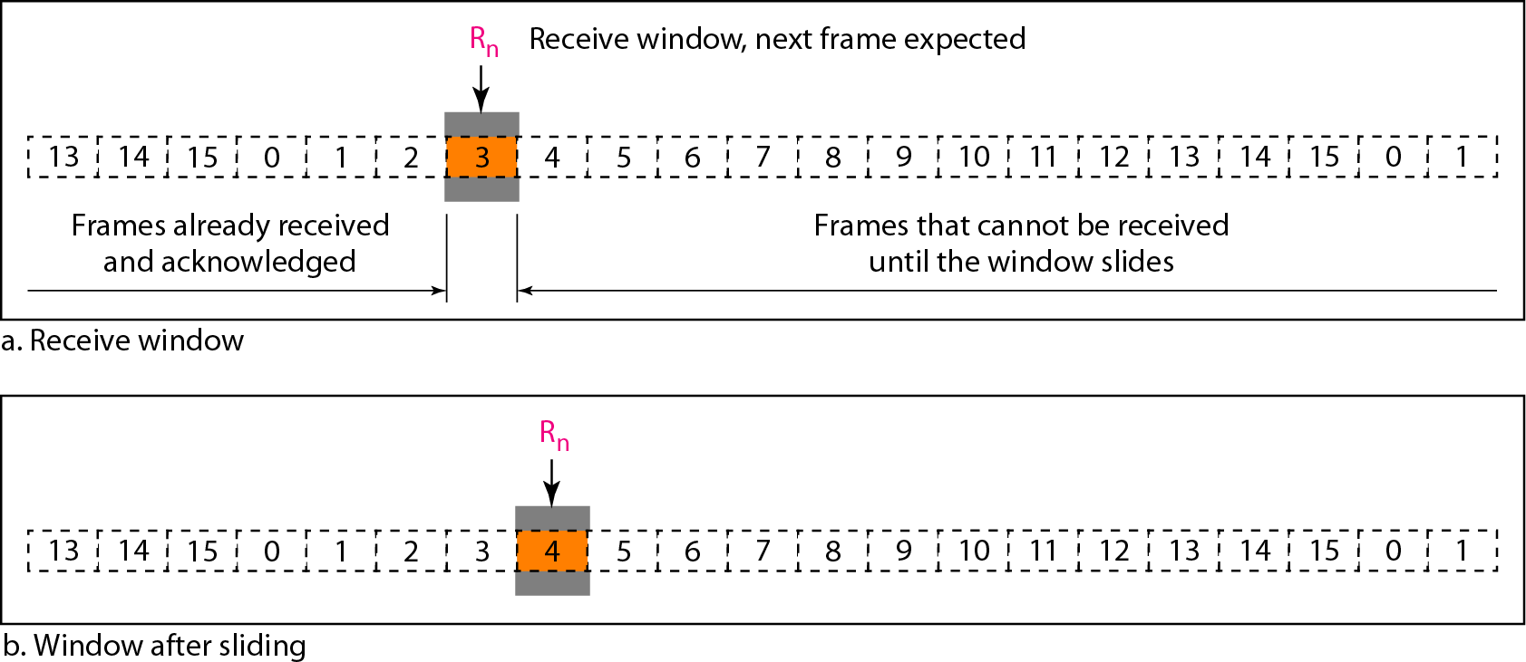
Receive window for Go-Back-N ARQ

Slide 37
The receive window is an abstract concept defining an imaginary box of size 1 with one single variable R_{n}.
The window slides
Note
when a correct frame has arrived; sliding occurs one slot at a time.

Slide 38
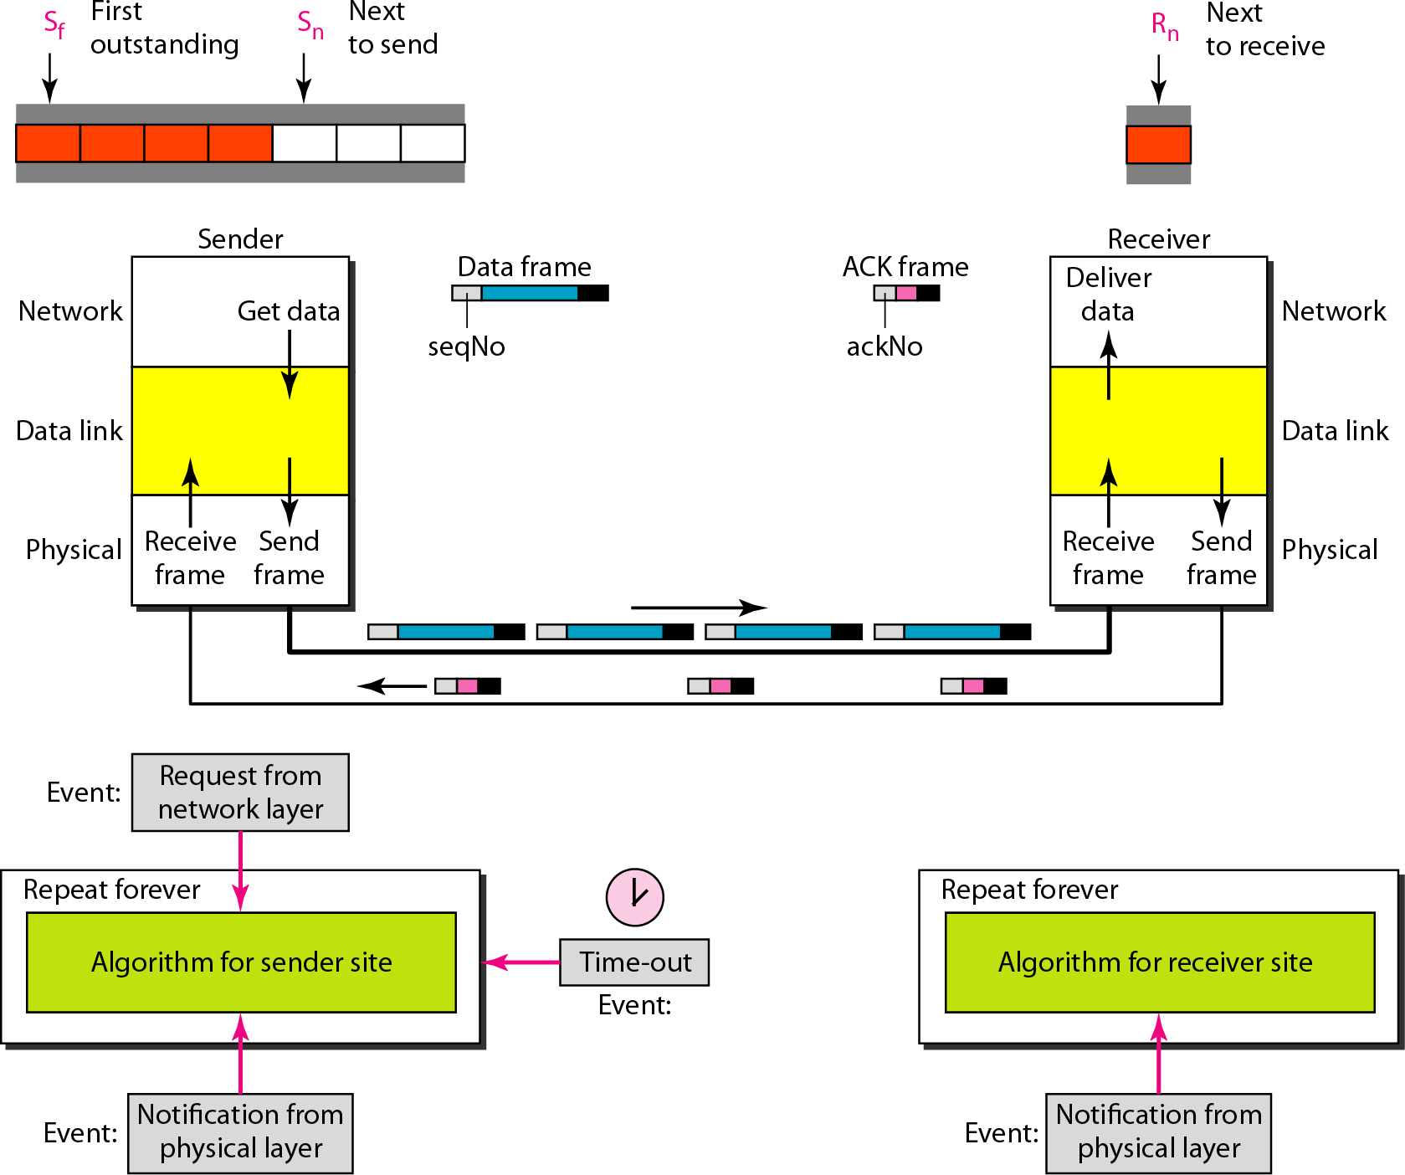
Design of Go-Back-N ARQ

Slide 39
Note
In Go-Back-N ARQ, the size of the send window must be less than 2^{m};
the size of the receiver window is always 1.

Slide 40
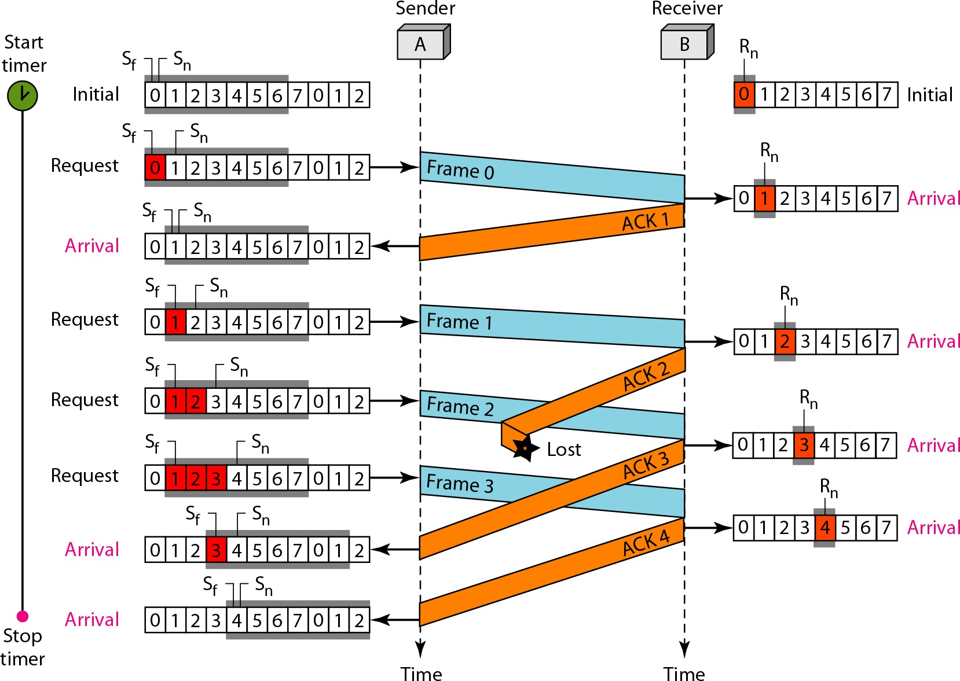
Flow diagram

Slide 41
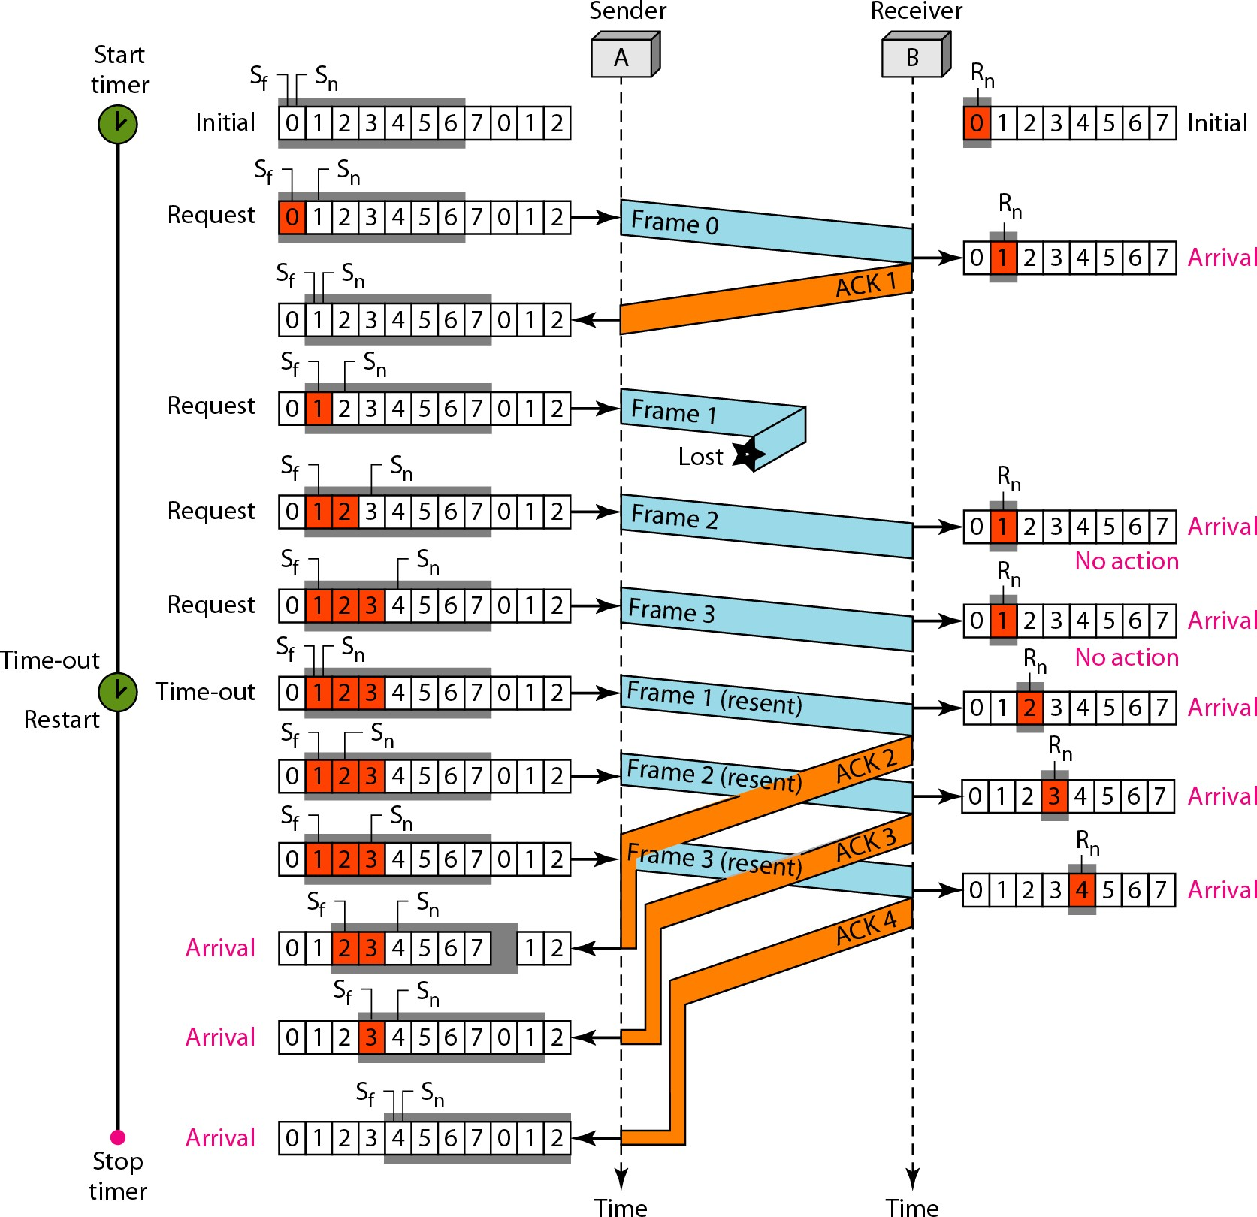
Flow diagram

Slide 42
Note
Stop-and-Wait ARQ is a special case of Go-Back-N ARQ in which the size of the send window is 1.

Slide 43
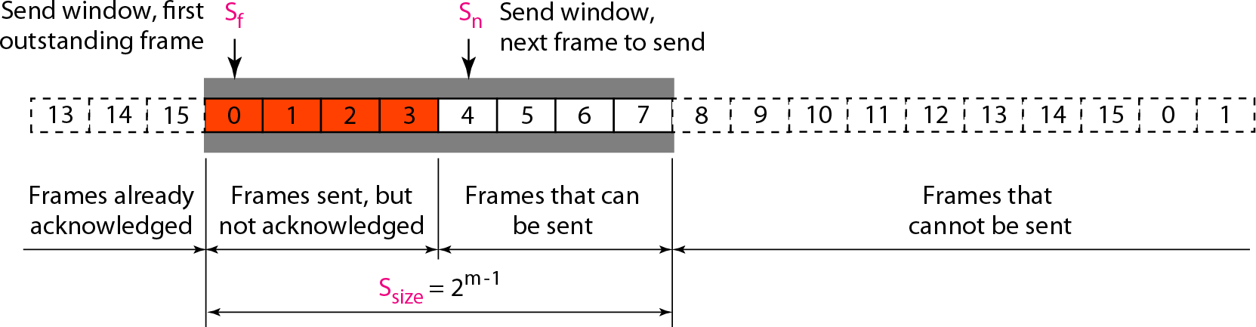
Send window for Selective Repeat ARQ

Slide 44
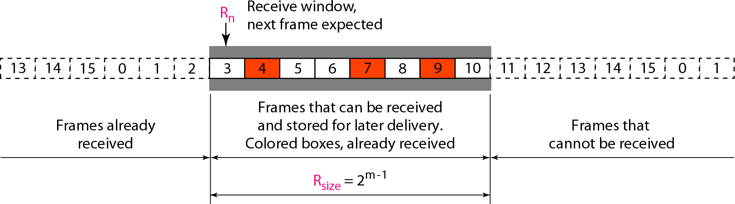
Receive window for Selective Repeat ARQ

Slide 45
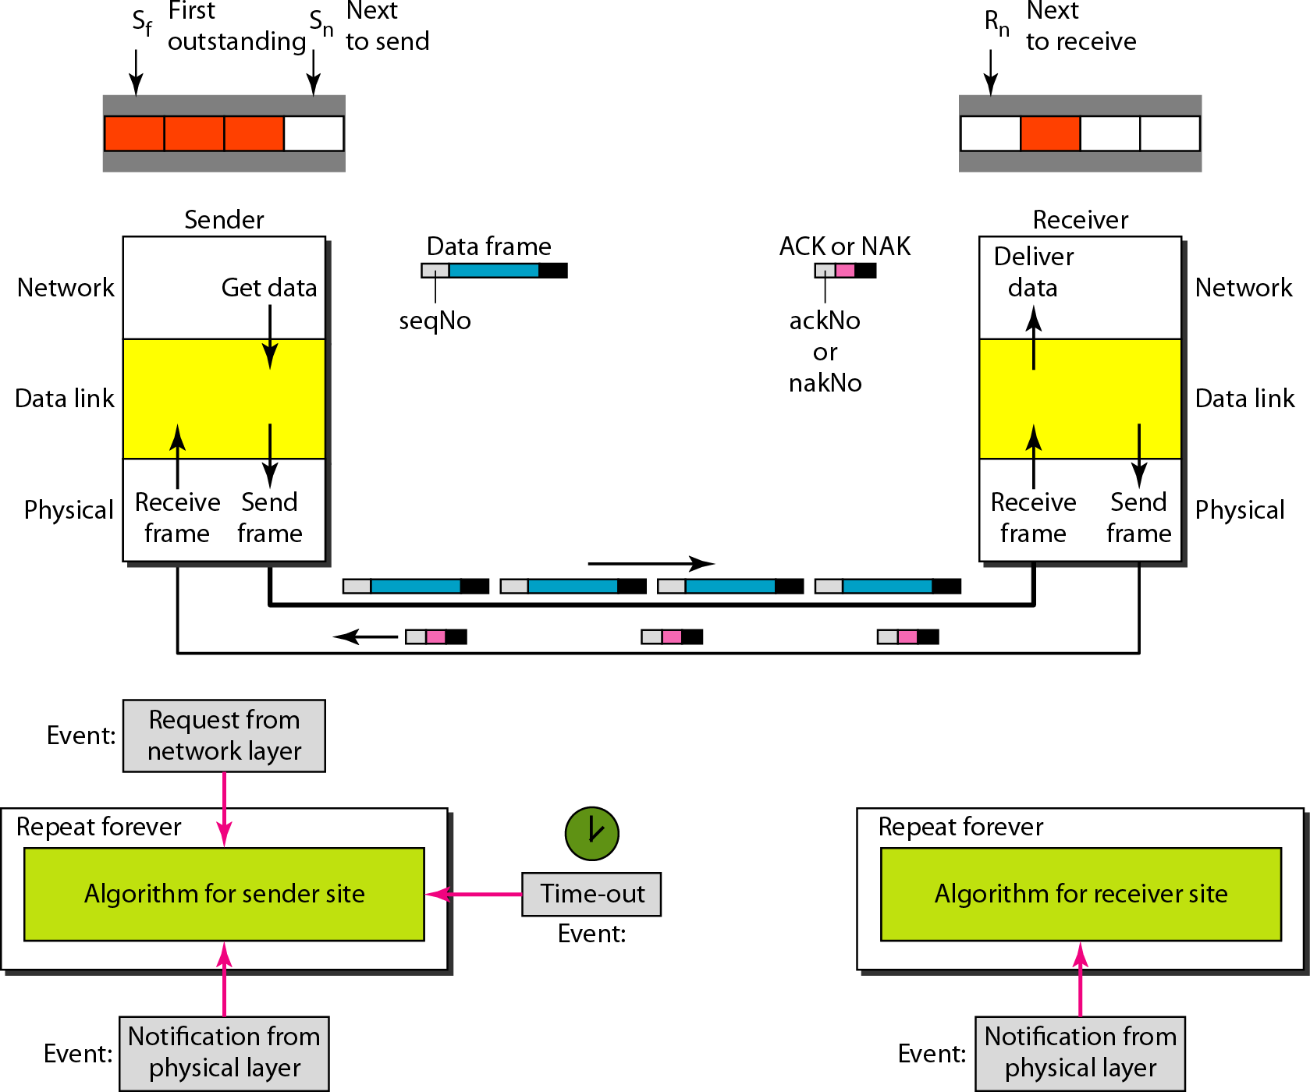
Design of Selective Repeat ARQ

Slide 46
Note
In Selective Repeat ARQ, the size of the sender and receiver window
must be at most one-half of 2^{m}.

Slide 47
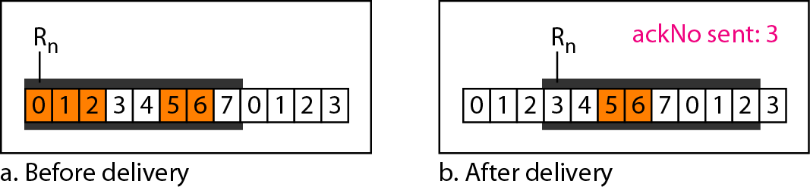
Delivery of data in Selective Repeat ARQ

Slide 48
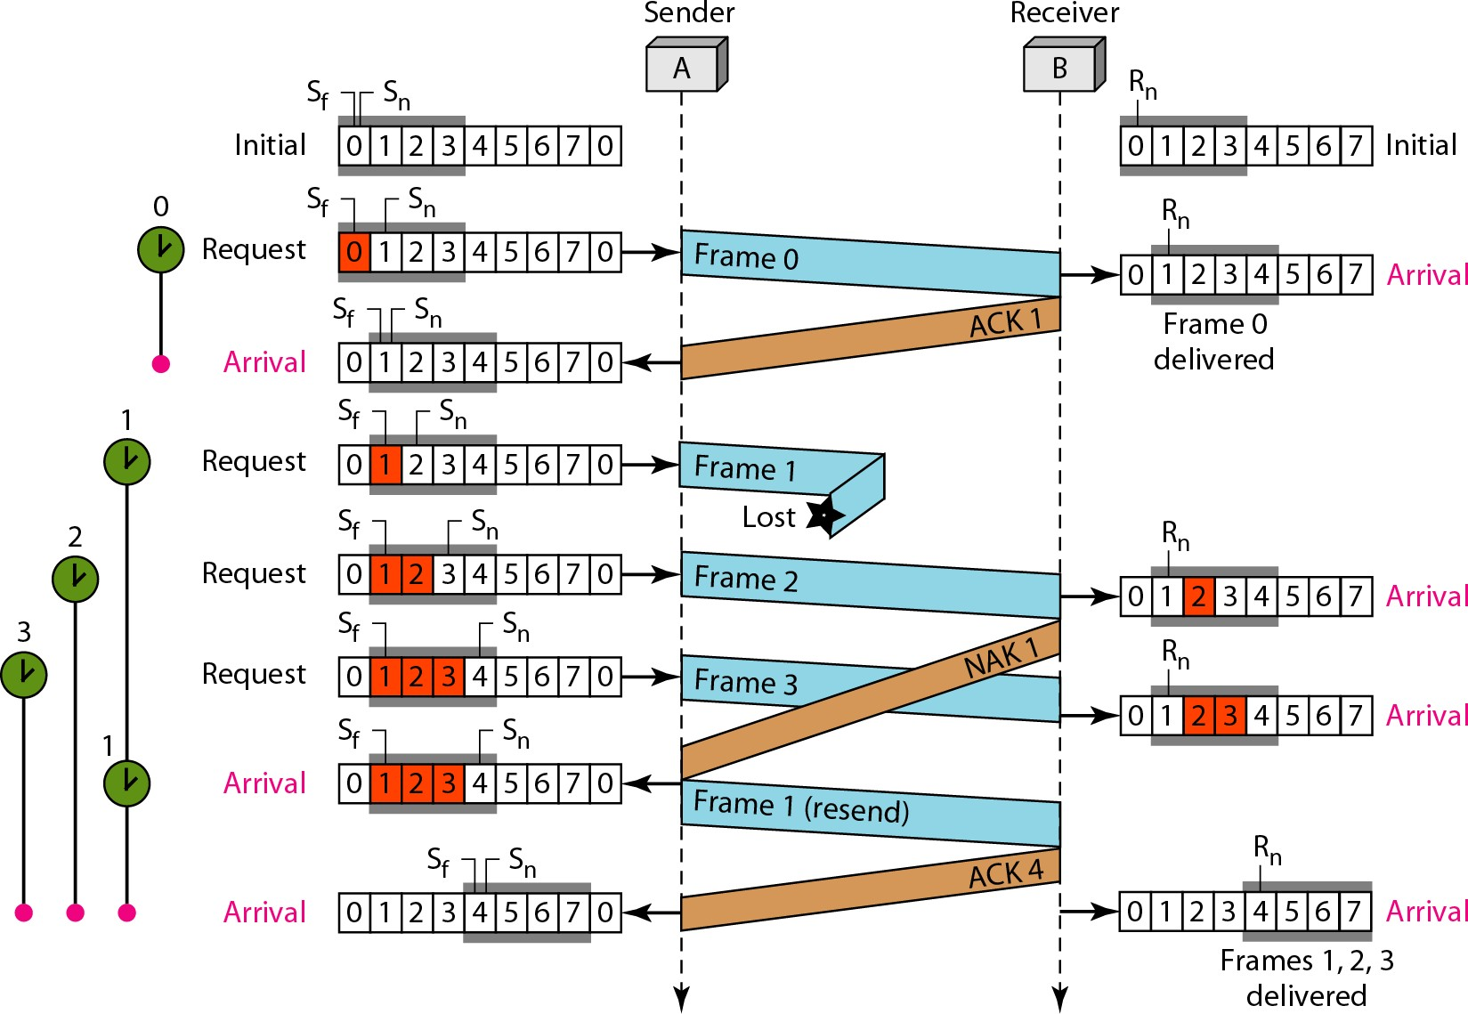
Flow diagram

Slide 49
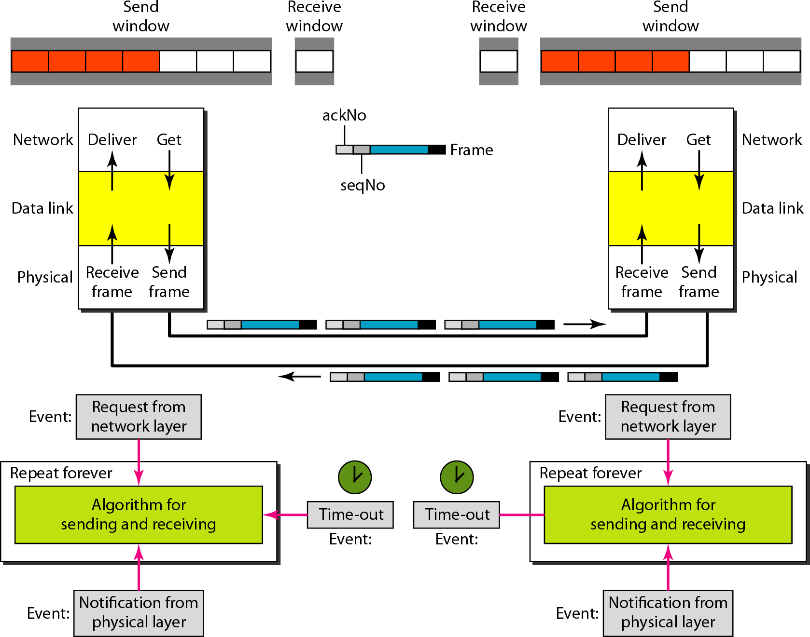
Design of piggybacking in Go-Back-N ARQ

